Slide 1
TEACHER’S PERSONAL INFORMATION
Name: Nguyen Thanh Loan
Facebook: Loan Nguyễn Thanh
Mobile number: 0942 255 937
Email: loannguyenthanh1978@gmail.com

Slide 2
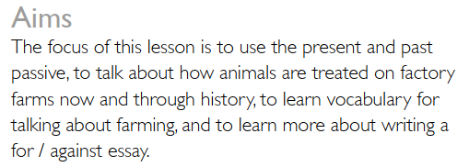
LESSON 2
KEPT IN SMALL PLACES

Slide 3
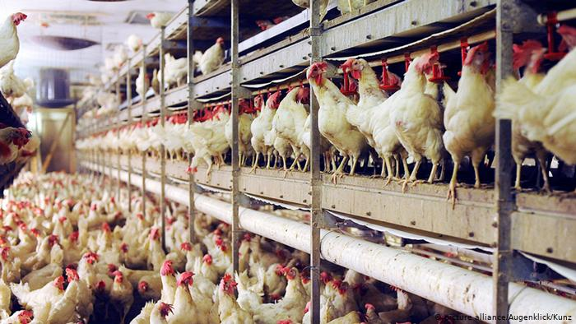
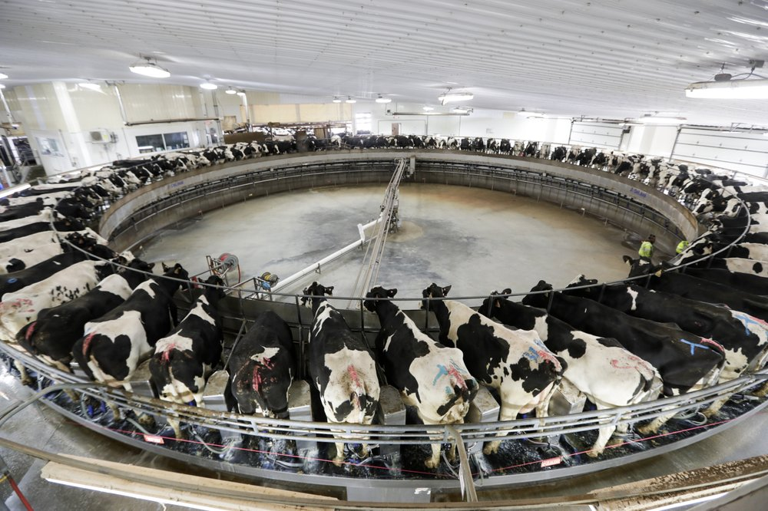
VOCABULARY
Farming
Factory farm
/ˈfæktri fɑːmɪŋ/
a method of farming in which a lot of animals are kept in small places and fed particular types of food in order to produce meat and other animal products quickly and cheaply
Một phương pháp chăn nuôi trong đó nhiều động vật được nuôi trong không gian nhỏ và cho ăn các loại thức ăn cụ thể để sản xuất thịt và các sản phẩm động vật khác một cách nhanh chóng và rẻ tiền

Slide 4
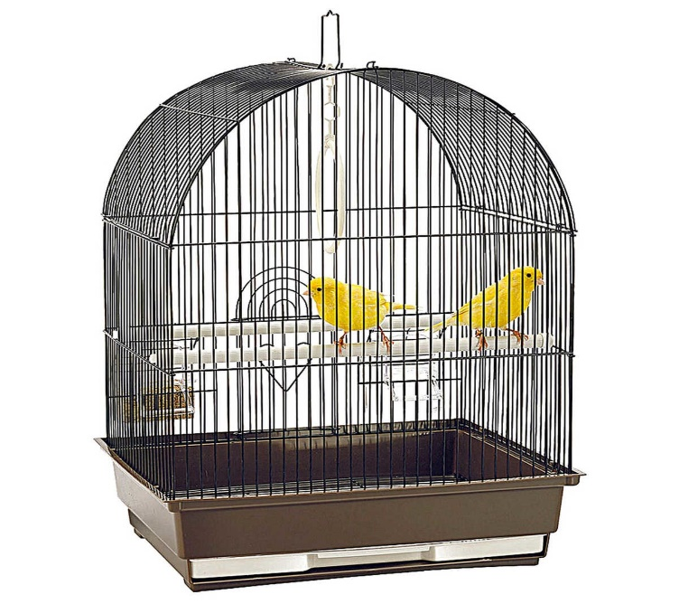
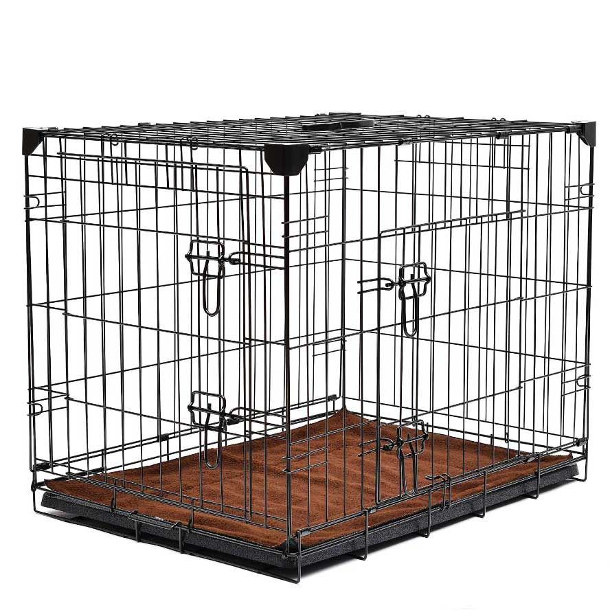
VOCABULARY
Farming
cage
/keɪdʒ/
a space surrounded on all sides by bars or wire, in which animals
or birds are kept
Ex: I don't like seeing animals in cages.

Slide 5
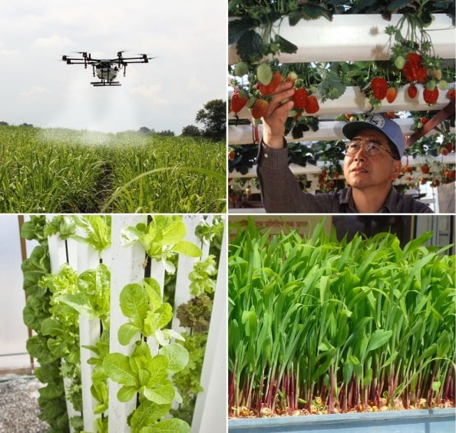
VOCABULARY
Farming
Farming methods
/ˈfɑːmɪŋˈmeθəd/

Slide 6
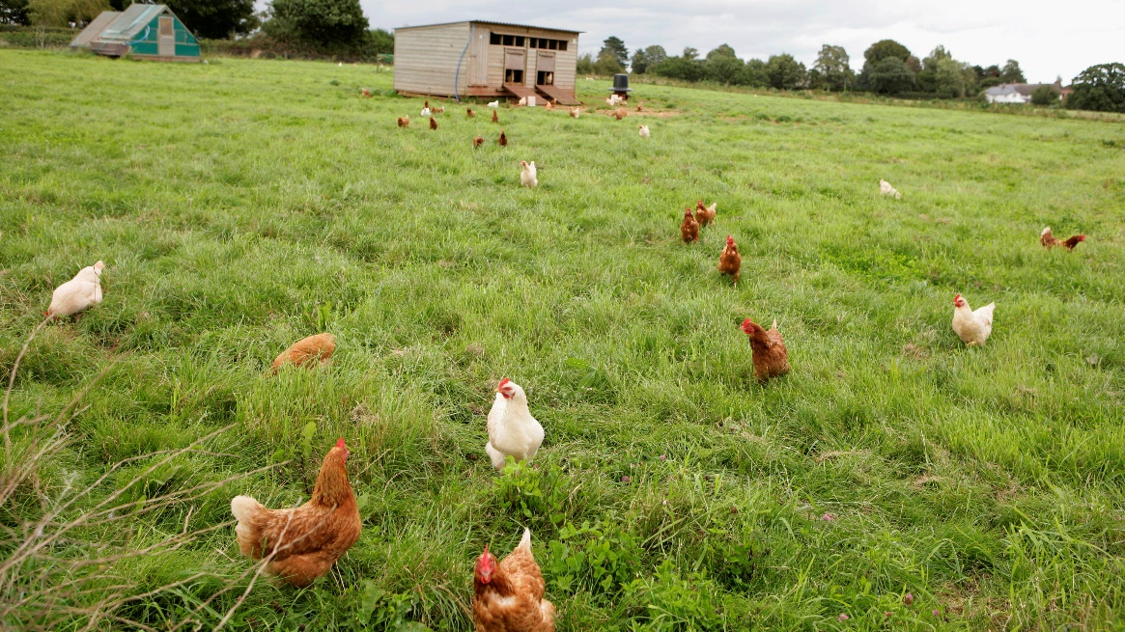
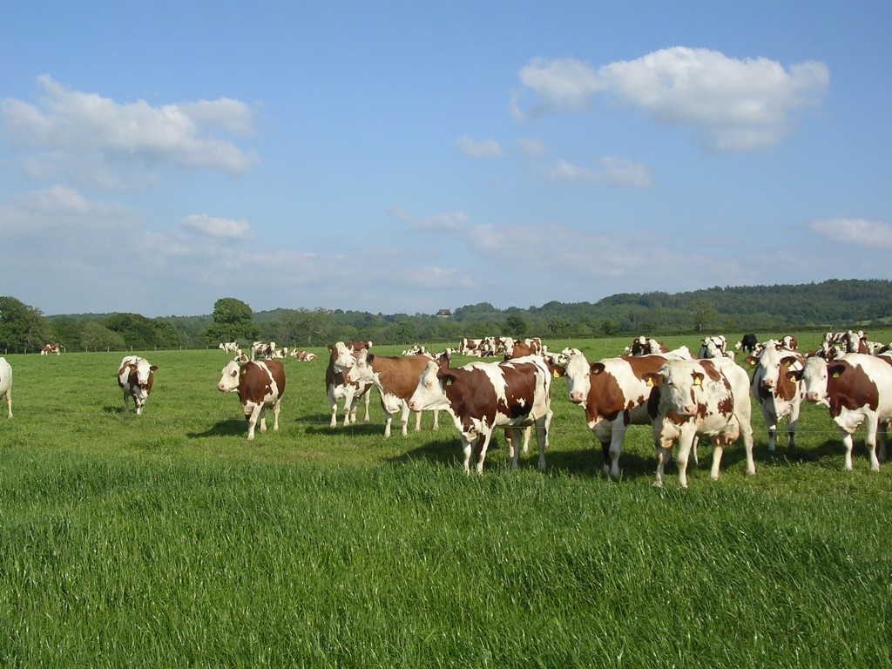
VOCABULARY
Farming
Free-range farm
/ˌfriː ˈreɪndʒ/
A farm that allows the animals to move around outside and are not kept in cages.

Slide 7
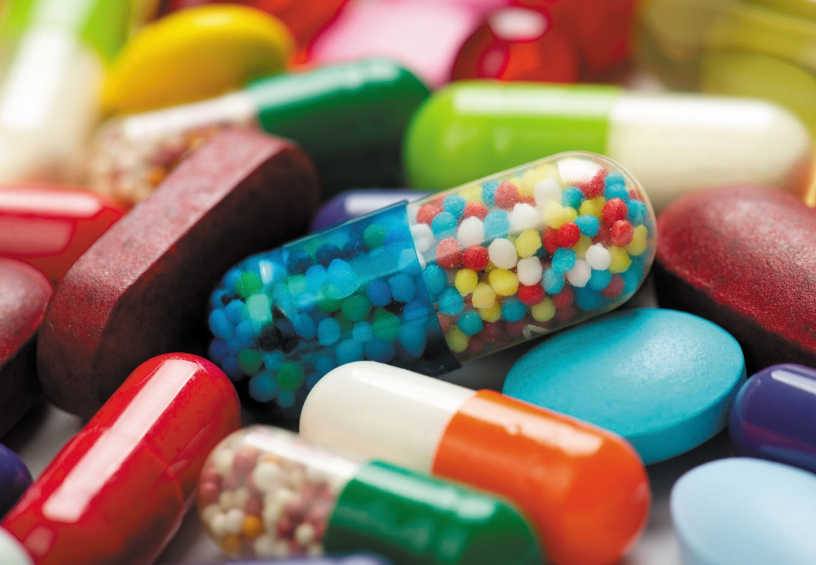
VOCABULARY
Farming
a substance, for example penicillin, that can destroy or prevent the growth of bacteria and cure infections
một chất, ví dụ như penicillin, có thể tiêu diệt hoặc ngăn chặn sự phát triển của vi khuẩn và chữa bệnh nhiễm trùng
antibiotics
/ˌæn.ti.baɪˈɒt.ɪk/

Slide 8
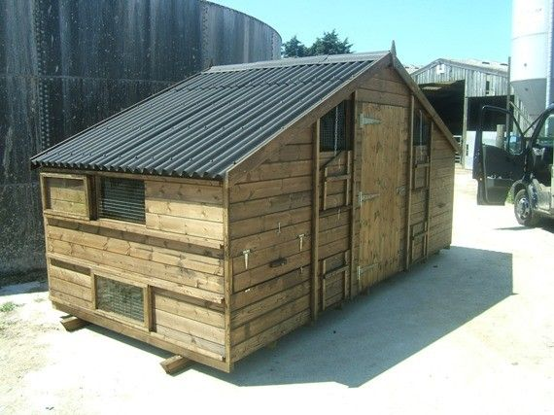
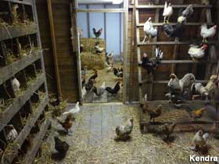
VOCABULARY
Farming
Shed /ʃed/
a small building, usually made of wood, used for storing things

Slide 9
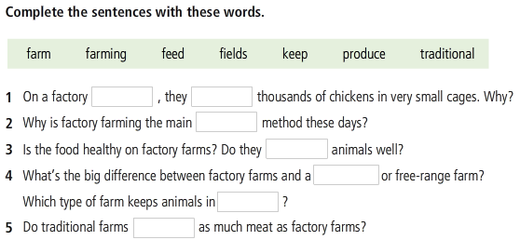
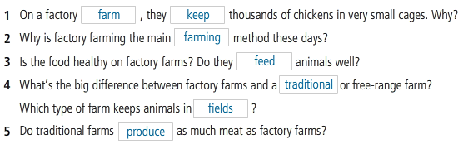
VOCABULARY
Farming

Slide 10
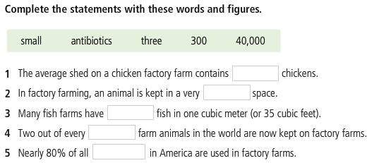
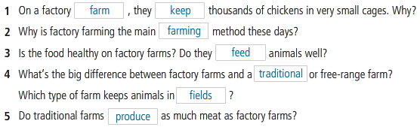
VOCABULARY
Farming

Slide 12
GRAMMAR
Present simple passive
They keep chickens in very small cages.
Chickens are kept (by them)in very small cages.
Past simple passive
Not so long ago, they kept chickens for their eggs.
Not so long ago, chickens were kept for their eggs.
https://www.youtube.com/watch?v=nRGLDD0BBdc

Slide 13
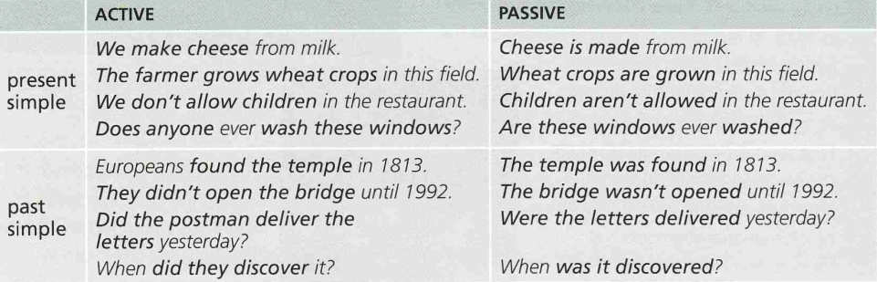
GRAMMAR
Present and past simple passive
https://www.youtube.com/watch?v=nRGLDD0BBdc

Slide 14
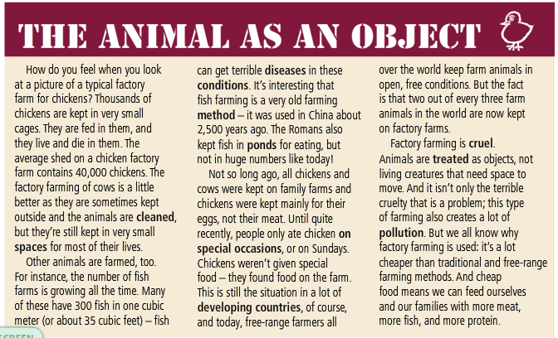
READING

Slide 15
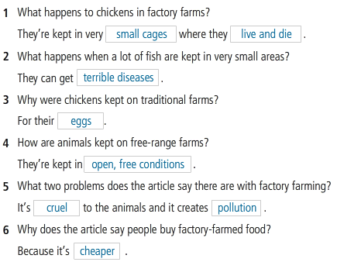
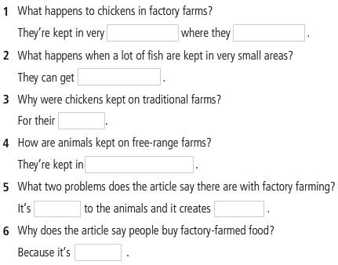
READING
Read the article and answer the questions.

Slide 16
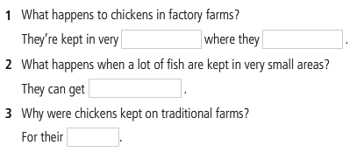
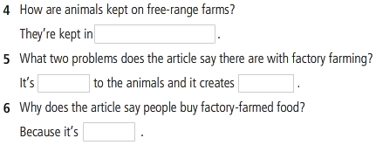
READING
Read the article and answer the questions.

Slide 17
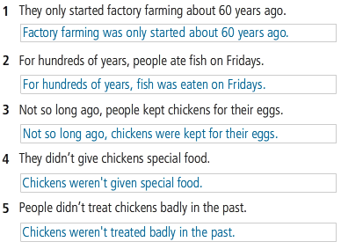
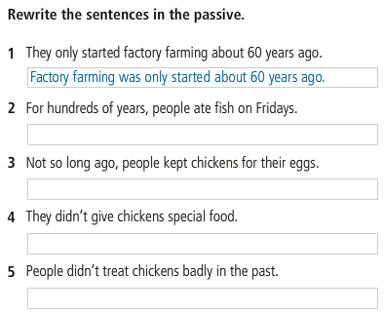
GRAMMAR 2

Slide 18
SPEAKING
Think and discuss these questions.
1. Would you change your eating habits after reading this article? Why? Why not?
2. What can we do to improve the conditions of animals on factory farms?

Slide 19
WRITING
“For and against” factory farming
Imagine that you take part in an online chat about factory farming. Are you for or against it? Write a paragraph giving your opinion and the reasons for your opinion.
I am ______ factory farming for these reasons.
Firstly, ___________________________________.
Secondly, _________________________________.
Thirdly, ___________________________________.

Slide 20
References
Vocabulary: Agriculture
https://www.youtube.com/watch?v=O8QPJq2Jhok
Reading
https://www.youtube.com/watch?v=5cNrkGx2CJQ
Grammar
https://www.youtube.com/watch?v=hI1d5NdEruM
Speaking and Listening
https://www.youtube.com/watch?v=7FBr-G0ur9I

